Slide 1

Subject Code: SITA1601 Subject Name: Mobile Application Development
Faculty Handling: Dr. R. M. Gomathi
Dr. Mohana Prasad

Slide 2
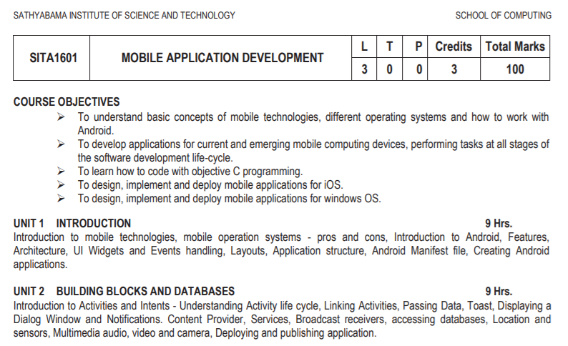

Slide 3
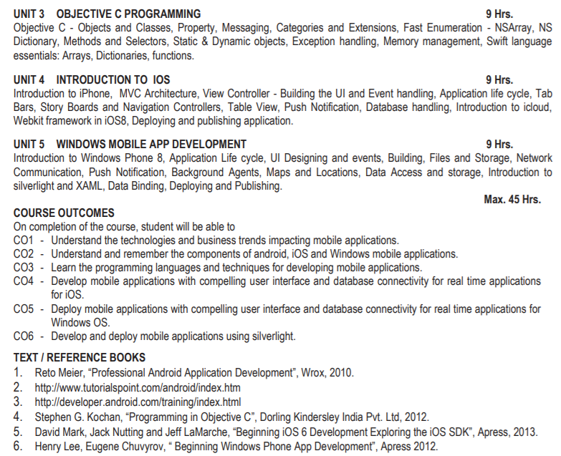

Slide 4
Unit- I - Introduction and UI interface
Introduction to mobile technologies
Mobile operating systems
Mobile devices – pros and cons
Introduction to Android, Versions,Features
Android architecture
UI Layouts
UI Controls / Widgets
to be contd.

Slide 5
Unit- I - Introduction and UI interface
8. Event handling
9. Required Tools- Eclipse, ADT, AVD
10. Application structure
11. Android manifest file
12. Android design philosophy
13. Creating Android Applications

Slide 6
1. Mobile Networks / Technologies
GSM – Developed by ETSI
GPRS
EDGE/EGPRS
1G, 2G, 3G, 4G, 5G
IEEE 802.11
Infrared
Bluetooth

Slide 7

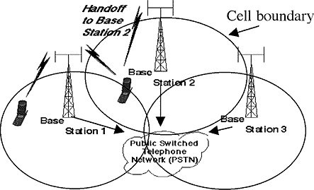
Base stations transmit to and receive from mobiles at the assigned spectrum
Multiple base stations use the same spectrum
The service area of each base station is called a cell
Each mobile terminal is typically served by the ‘closest’
base stations
Handoff when terminals move

Slide 8
Cellular Network Generations
It is useful to think of cellular Network/telephony in terms of generations:
0G: Briefcase-size mobile radio telephones
1G: Analog cellular telephony
2G: Digital cellular telephony
3G: High-speed digital cellular telephony (including
video telephony)
4G: IP-based “anytime, anywhere” voice, data, and multimedia telephony at faster data rates than 3G
5G : Exponentially faster download and upload speeds

Slide 9
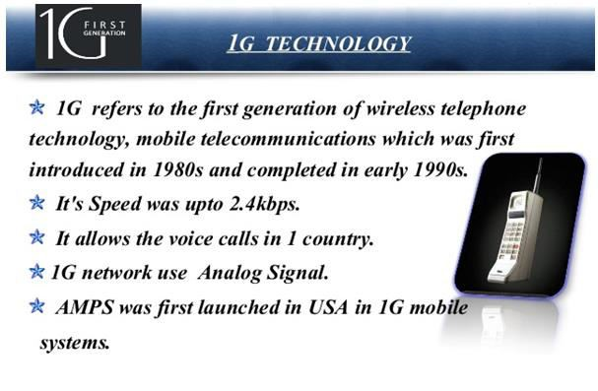

Slide 10
1G - Characteristics
First generation analog cellular technology
Radio signals - analog
Poor voice quality
Technologies - AMPS (Analog Mobile Phone System)
Large phones with limited battery - First Blackberry (850)

Slide 11
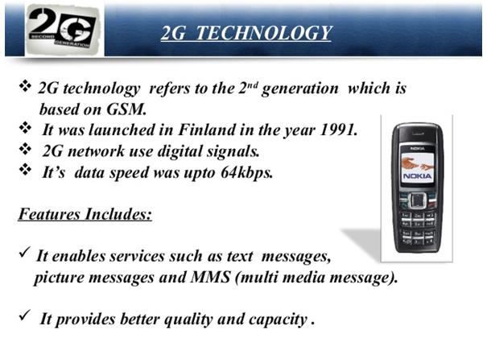

Slide 12
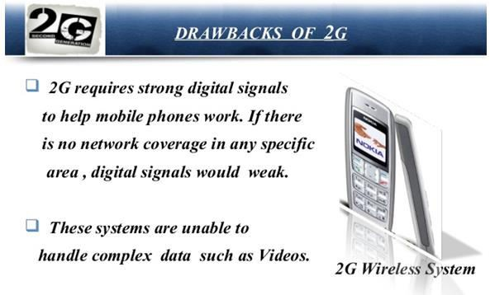

Slide 13
2G & 2.5G
2G carriers continued to improve transmission quality and coverage paging, faxes, text messages and voicemail.
2.5G uses GPRS(General Packet Radio Services), which adds packet-switched capabilities to existing GSM networks.
2.5G enables web browsing, e-mail and fast upload/download.
2G + GPRS 2.5G
12

Slide 14
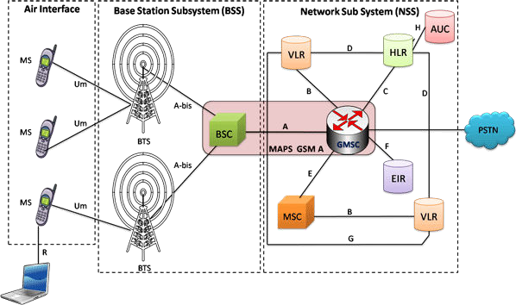
GSM Architecture

Slide 15
The Global System for Mobile Communications (GSM) is a standard developed by the European Telecommunications Standards Institute (ETSI)
Based on digital technology
It describes the protocols for second-generation (2G) digital cellular networks used by mobile devices such as mobile phones and tablets
The GSM network architecture can be grouped into four main areas:
Network and Switching Subsystem (NSS)
Base-Station Subsystem (BSS)
Mobile station (MS)
Operation and Support Subsystem (OSS)

Slide 16
Mobile Station (MS)
Mobile Equipment (ME) Subscriber Identity Module (SIM)
Base Station Subsystem (BSS)
Base Transceiver Station (BTS) Base Station Controller (BSC)
Network Switching Subsystem(NSS) Mobile Switching Center (MSC)
Home Location Register (HLR)
Visitor Location Register (VLR)
Authentication Center (AUC)
Equipment Identity Register (EIR)

Slide 17
SYSTEM ARCHITECTURE MOBILE STATION (MS)
The Mobile Station is made up of two entities:
Mobile Equipment (ME)
Subscriber Identity Module (SIM)

Slide 18
MOBILE EQUIPMENT
They are most widely known as cell or mobile phones
Portable, vehicle mounted, hand held device
The two main elements are the main hardware and the SIM.
The hardware itself contains the main elements of the mobile phone including the display, case, battery etc.
Uniquely identified by an IMEI (International Mobile
Equipment Identity)
Voice and data transmission
It is accessed by the network during registration to check whether the equipment has been reported as stolen

Slide 19
SUBSCRIBER IDENTITY MODULE(SIM)
The SIM or Subscriber Identity Module contains the information that provides the identity of the user to the network
It contains are variety of information including a number known as the International Mobile Subscriber Identity (IMSI)
Allows user to send and receive calls and receive other subscribed services
Protected by a password or PIN
Can be moved from phone to phone – contains key
information to activate the phone

Slide 20
SYSTEM ARCHITECTURE
BASE STATION SUBSYSTEM (BSS)
Base Station Subsystem is composed of two parts that communicate across the standardized Abis interface allowing operation between components made by different suppliers
Base Transceiver Station (BTS)
Base Station Controller (BSC)

Slide 21
BASE TRANSCEIVER STATION (BTS):
The BTS comprises the radio transmitter receivers, and antennas that transmit and receive to directly communicate with the mobiles.
The BTS is the defining element for each cell
The BTS communicates with the mobiles and the interface between the two is known as the Um interface with its associated protocols.
Communicates with Mobile station and BSC
Consists of Transceivers (TRX) units

Slide 22
BASE STATION CONTROLLER (BSC)
The BSC forms the next stage back into the GSM network.
It controls a group of BTSs, and is often co-located with one of the BTSs in its group.
It manages the radio resources and controls items such as handover within the group of BTSs, allocates channels and the like.
It communicates with the BTSs over what is termed the Abis interface.

Slide 23
SYSTEM ARCHITECTURE
NETWORK SWITCHING SUBSYSTEM(NSS)
The system contains the following functional units
Mobile Switching Center (MSC) Home Location Register (HLR) Visitor Location Register (VLR) Authentication Center (AUC) Equipment Identity Register (EIR)

Slide 24
MOBILE SWITCHING CENTER (MSC)
Heart of the network
Provides additional functionality to enable the requirements of a mobile user to be supported.
These include registration, authentication, call location, inter-MSC handovers and call routing to a mobile subscriber.
It also provides an interface to the PSTN so that the mobile communications calls can be routed from the mobile network to a phone connected to a landline.
Interfaces to other MSCs are provided to enable calls to be made to mobiles on different networks

Slide 25
HOME LOCATION REGISTERS (HLR)
This database contains all the administrative information about each subscriber along with their last known location
Stores information about each subscriber that belongs to it MSC in permanent and temporary fashion.
As soon as mobile subscriber leaves its current local area, the information in the HLR is updated.
Database contains IMSI, prepaid/ postpaid, roaming restrictions, supplementary services.

Slide 26
VISITOR LOCATION REGISTERS (VLR)
Temporary database which updates whenever new MS enters its area, by HLR database
Assigns a TMSI to each MS entering the VLR area which keeps on changing
Database contains IMSI, Location Area, authentication key
AUTHENTICATION CENTER (AUC)
It is a protected database that contains the secret key also contained in the user's SIM card
Contains the algorithms for authentication as well as the keys for encryption
Protects network operators from fraud
Situated in special protected part of the HLR

Slide 27
EQUIPMENT IDENTITY REGISTER (EIR)
The EIR is the entity that decides whether a given mobile equipment may be allowed onto the network
Dependent upon the information held in the EIR, the mobile may be allocated one of three states - allowed onto the network, barred access, or monitored in case its problems
Database that is used to track handsets using the IMEI
(International Mobile Equipment Identity)
Prevents calls from stolen, unauthorised or defective mobile devices

Slide 28
GSM Evolution to 3G (con...)
Start of new millennium and major advancements.
Data speed of 144 kbps to 2 mbps
W-CDMA (Wide Band Code Division Multiple Access) technology
Fast & easy transfer of audio and video files
Running web based applications like video conferencing, multimedia, e-mail etc.

Slide 29
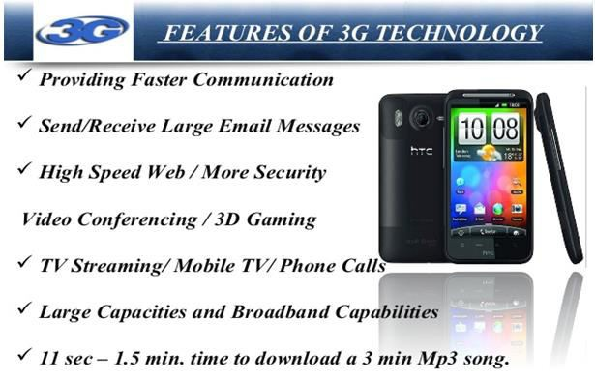
16

Slide 30
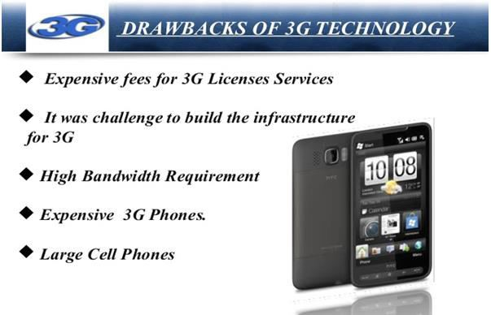
19

Slide 31
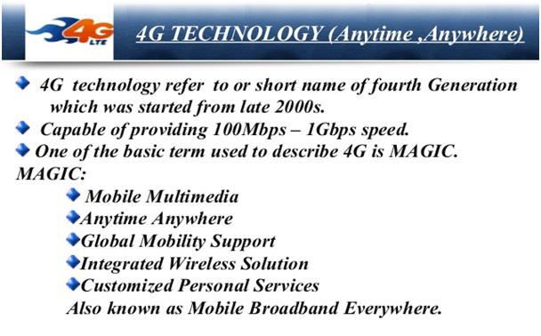
20

Slide 32
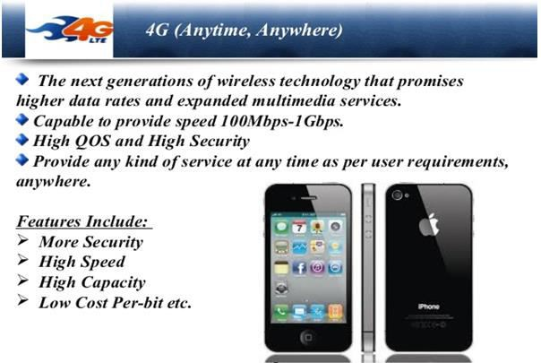
21

Slide 33
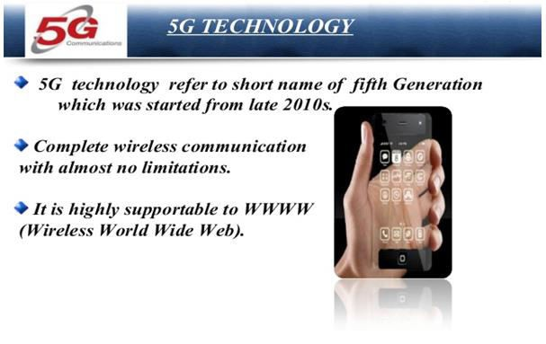
22

Slide 34






2. Mobile Operating Systems

Slide 35
What is Mobile OS?
A Mobile OS is a very basic and essential software to operate a Mobile System.
A Mobile OS is a software platform which is designed specially for mobile to handle the devices like Smart phone, Tablet, PDA with lot of features and facilities.

Slide 36

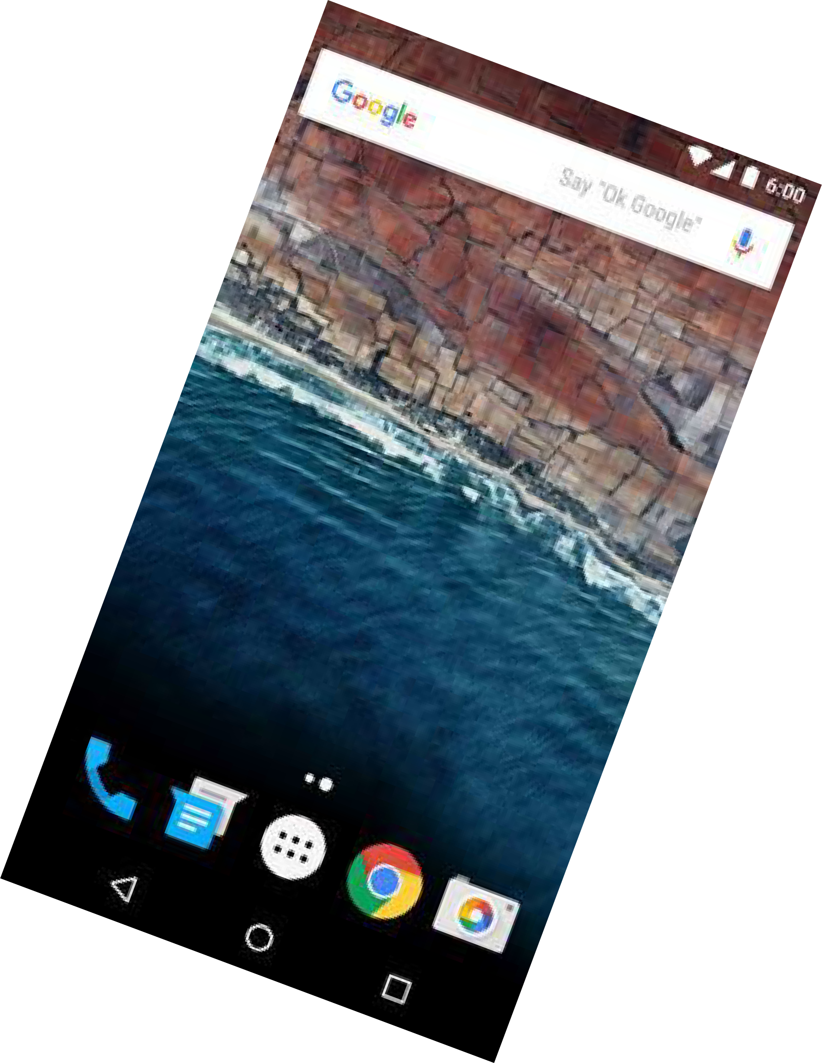

Slide 37

Android
Android is a mobile operating system (OS) currently developed by Google, based on the Linux kernel and designed primarily for touchscreen mobile devices such as smartphones and tablets.
It was developed by Google, Open Handset Alliance, Android Open Source Project, Android Inc.
Source model, open source
Written in C (core), C++, and Java (UI)
OS family, Unix

Slide 38
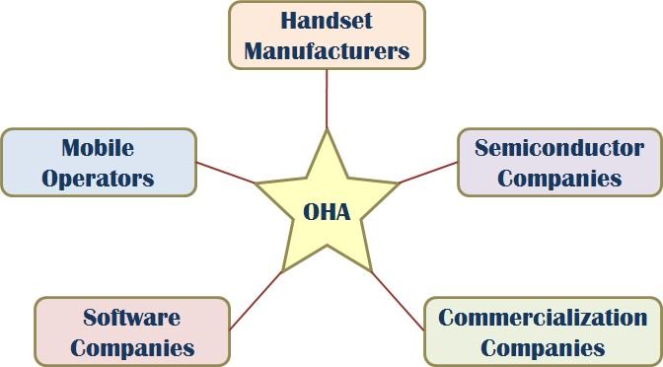
OHA (Open Handset Alliance)
A business alliance consisting of 84 companies to develop open standards for mobile devices

Slide 39
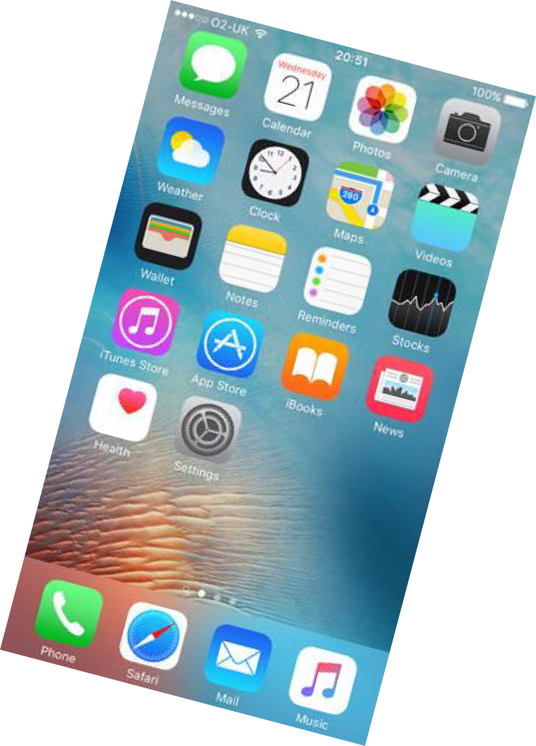
Apple iOS

Slide 40

iOS
iOS (originally iPhone OS) is a mobile operating system created and developed by Apple Inc. and distributed exclusively for Apple hardware. It is the operating system that presently powers many of the company's mobile devices, including the iPhone, iPad, and iPod touch.
It was developed by Apple Inc. June 29, 2007
- Source model, closed source
Written in, C,C++, Objective-C, and Swift
OS family, Unix

Slide 41
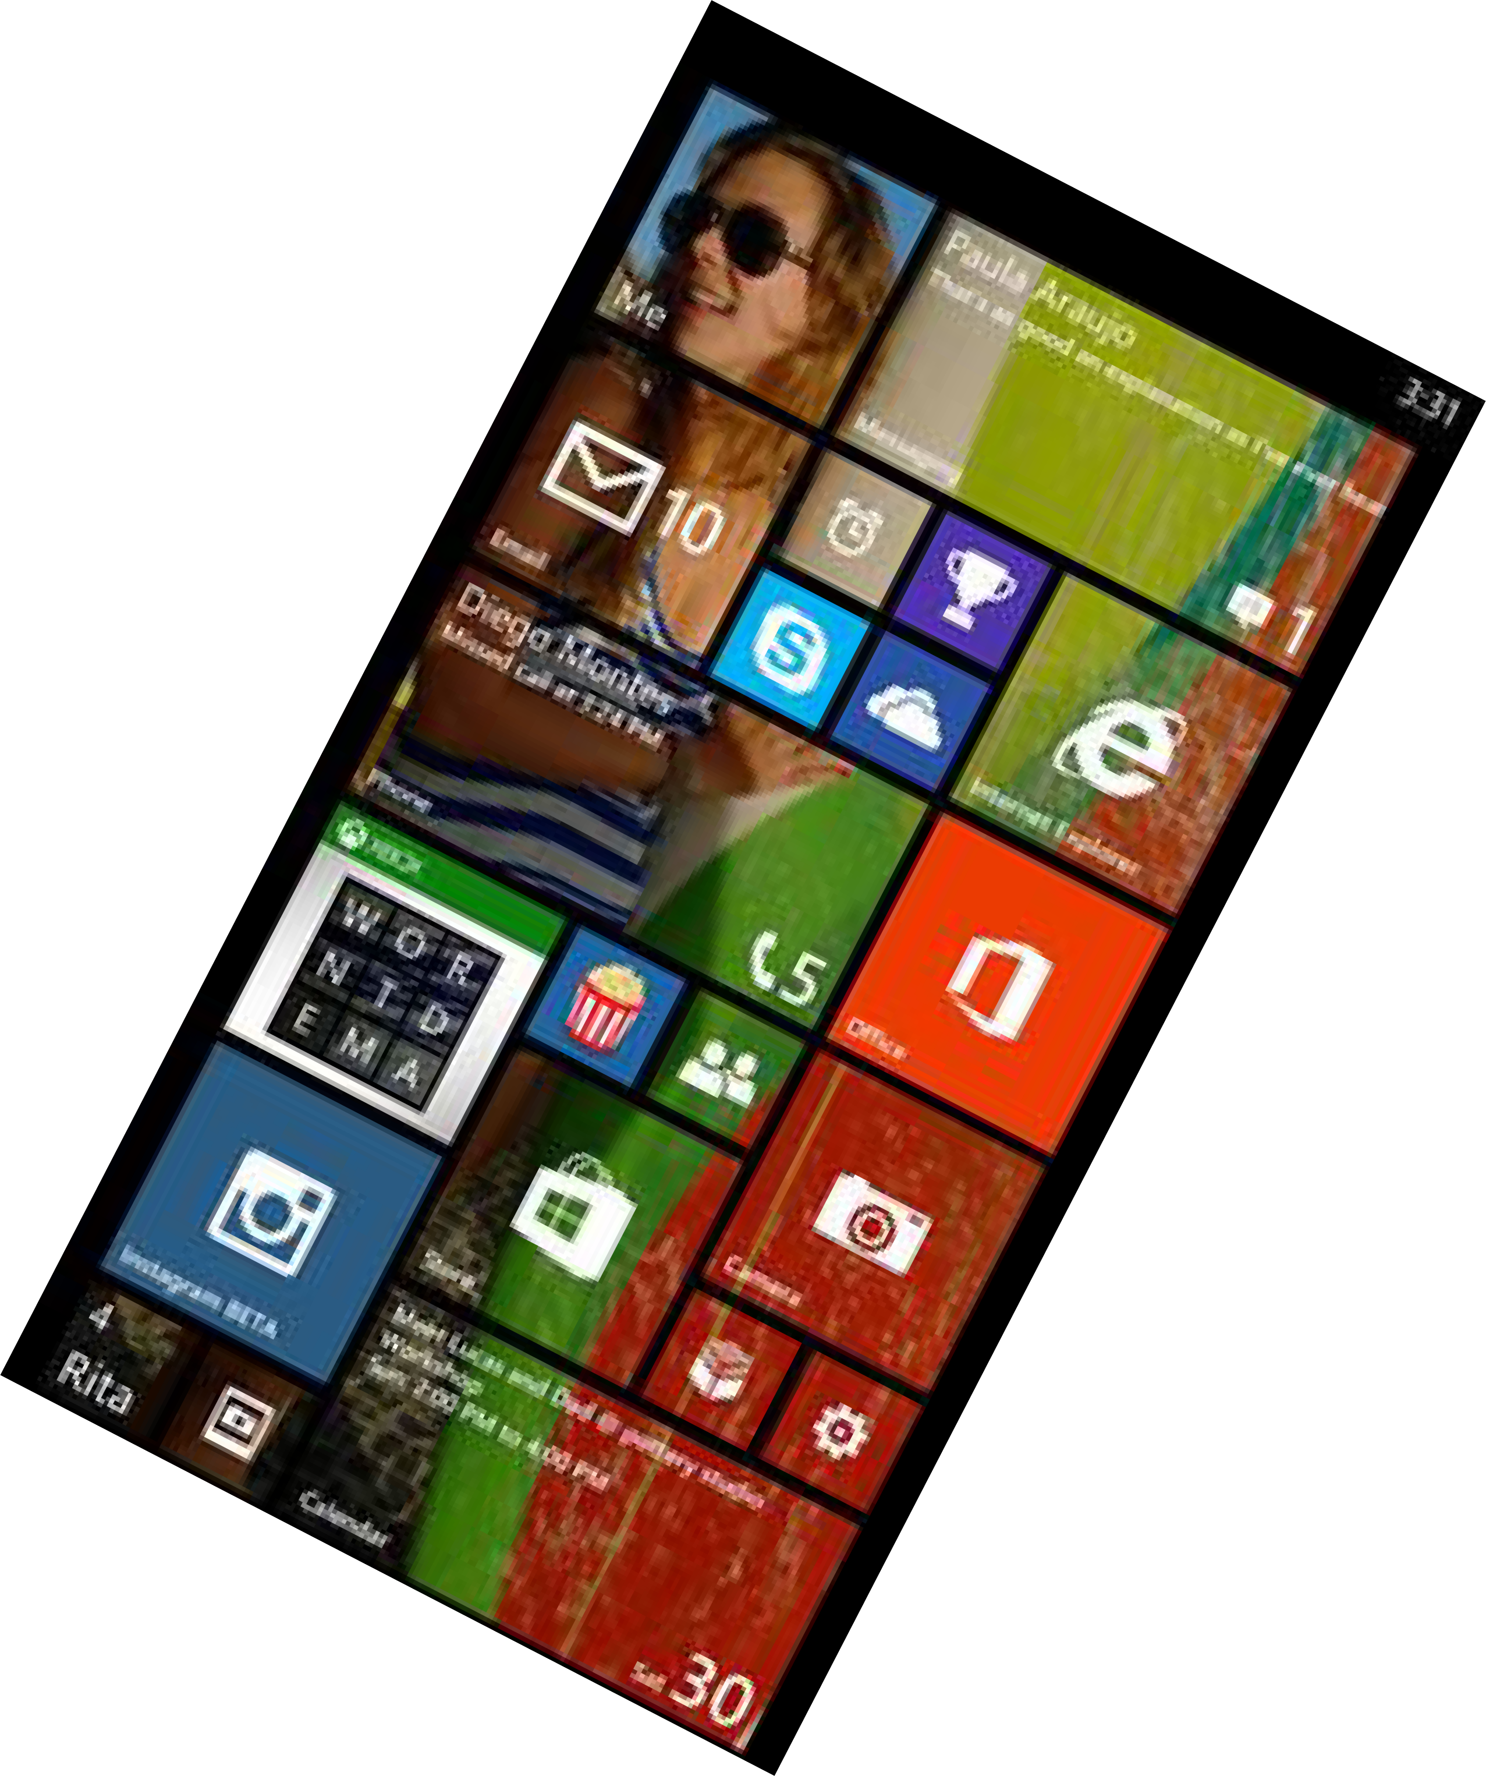
Windows

Slide 42

Windows Mobile
Windows Mobile is a mobile operating system developed by Microsoft for smart phones and Pocket PC’s
It was first launched in October 2010 with Windows Phone 7
Currently maintained with Micosoft Corporation
Written in C, C++
OS Family, Microsoft Windows

Slide 43
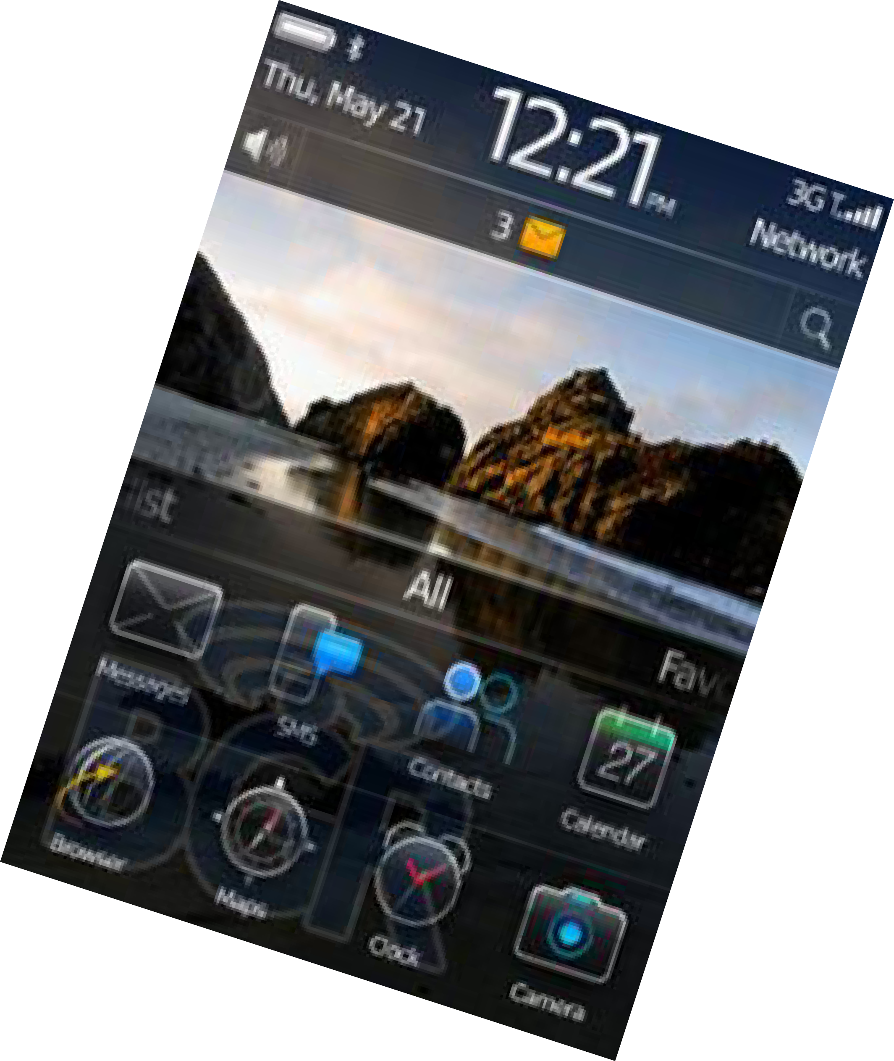
Blackberry

Slide 44


Blackberry
- BlackBerry OS is a proprietary mobile operating system developed by BlackBerry Ltd for its BlackBerry line of smartphone handheld devices.
It was developed by BlackBerry January 19, 1999
Source model is closed source
Written in, C++ and Java
OS family, Mobile Operating Systems

Slide 45
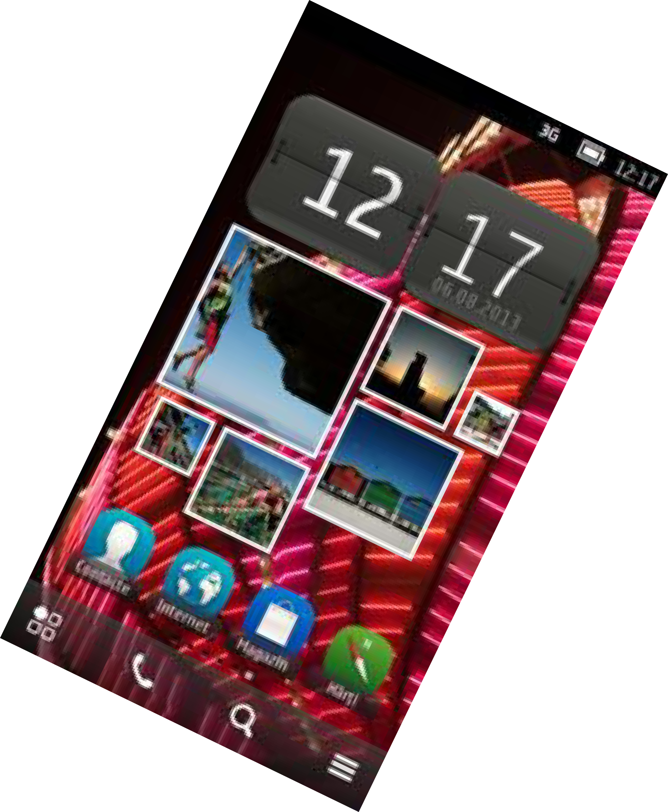

Symbian

Slide 46

Symbian
Symbian is a mobile operating system (OS) and computing platform designed for smart phones
Symbian was originally developed as a closed- source OS for PDAs in 1998 by Symbian Ltd.
Currently maintained by Accenture on behalf of
Nokia (historically Foundation)
Written in C++
OS Family RTOS
Symbian Ltd. and Symbian

Slide 47
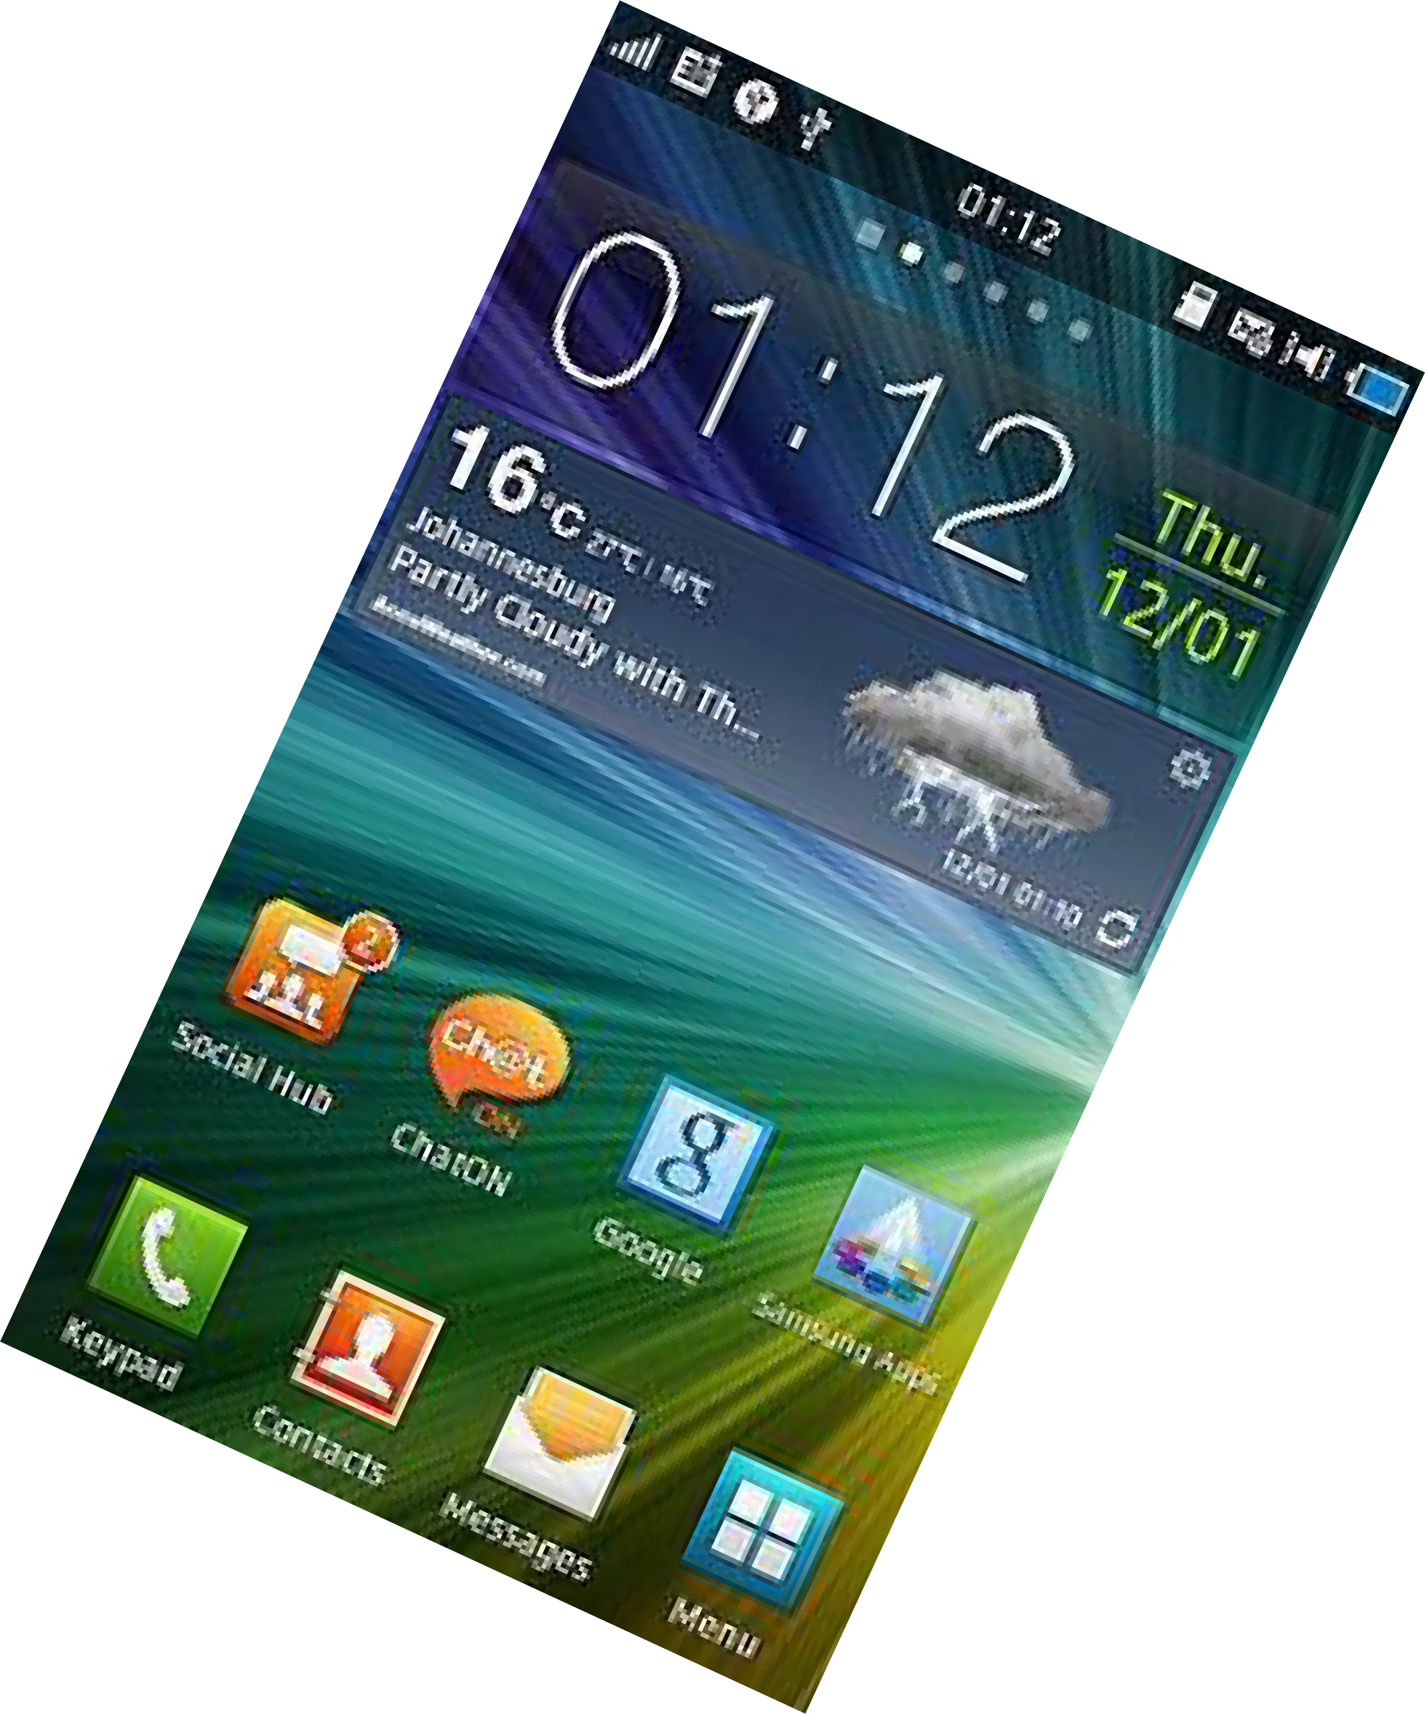
Bada

Slide 48

BADA
Bada is an operating system for mobile devices such as smartphones and tablet computers.
It was developed by Samsung Electronics on April 2010.
Source model is, Mixed: proprietary and open source
Written in C++
OS Family, POSIX (Portable Operating System Interface for Unix)

Slide 49
Why Mobile App Development?
Mobile platform is the platform of the future world
Job market is hot
Market for mobile software surges from $4.1 billion in 2009 to
$17.5 billion by 2012
In 2010, www.dice.com survey: 72% of recruiters looking for iPhone app developers, 60% for Android
Dice.com: mobile app developers made $85,000 in 2010 and
salaries expected to rise
According to 2016 surveyed, 79% of the organizations plan to increase spending on mobile development by 36%

Slide 50
Types of Mobile Appications
What are they?
Any application that runs on a mobile device
Types
Web Apps
Native Apps
Hybrid Apps

Slide 51
Types of Mobile...(con...)
Native Apps
It is live on the device and are accessed through icons on the device home screen.
They are installed through an application store (such as Google Play or Apple’s App Store).
They are developed specifically for one platform, and can take full advantage of all the device features — they can use the camera, the GPS, the accelerometer, the compass, the list of contacts, and so on.

Slide 52
Types of Mobile...(con...)
Web Apps
They are not real applications; they are really websites that, in many ways, look and feel like native applications, but are
not implemented as such.
They are run by a browser and typically written in HTML5
Web apps became really popular when HTML5 came around and people realized that they can obtain native-like functionality in the
browser.

Slide 53
Types of Mobile...(con...)
Hybrid apps
Hybrid apps are part native apps, part web apps.
Like native apps, they live in an app store and can take advantage of the many device features available.
Like web apps, they rely on HTML being rendered in a browser, that the browser is embedded within the app.

Slide 54
3. Mobile Devices: Advantages (as compared to fixed devices)
Always with the user
Wireless – easily carried
Communication easy
Typically have Internet access
Typically GPS enabled
Audio, Video can be sent
Mostly have cameras, calculator, & microphones
Many apps are free or low-cost and etc.,

Slide 55
Mobile Devices: Limitations
Limited memory
Limited processing power
Different technologies and standards
Limited or awkward input: soft keyboard, phone keypad, touch screen, or stylus
Small screens
Limited and slow network access
Slow hardware
Limited battery life
Limited web browser functionality
Often inconsistent platforms across devices and etc...
44

Slide 56

Android
Mobile Application Development

Slide 57
Prerequisite
Good knowledge of JAVA language
Familiarity with Eclipse IDE

Slide 58
4. Introduction to Android
Open software platform for mobile development
A complete stack – OS, Middleware, Applications
An Open Handset Alliance (OHA) project
Powered by Linux operating system
Fast application development in Java
Open source under the Apache 2 license

Slide 59
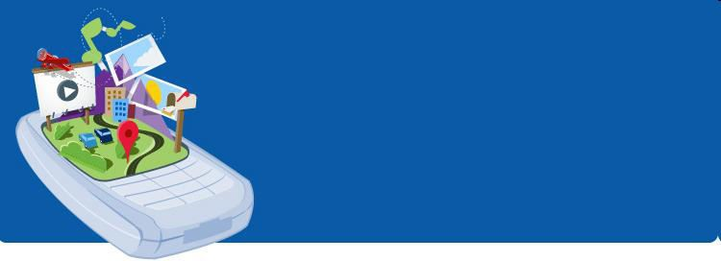
What is Android?
Android is a software stack for mobile devices that includes an operating system, middleware and key applications.

Slide 60
Developed by
Andy Rubin (co-founder of Danger),
Rich Miner (co-founder of Wildfire Communications Inc.),
Nick Sears (once VP at T-Mobile)
Chris White (headed design and interface development at WebTV)

Slide 61
History of Android
1) Initially, Andy Rubin founded Android Incorporation in Palo Alto, California, United States in October, 2003.
2) In 17th August 2005, Google acquired Android Incorporation. Since then, it is in the subsidiary of Google Incorporation.
3) The key employees of Android Incorporation are Andy Rubin, Rich Miner, Chris White and Nick Sears.
50

Slide 62
History of Android (con...)
4) Originally intended for camera but shifted to smart phones later because of low market for camera.
5) Android is the nick name of Andy Rubin given by coworkers because of his love to robots.
6) In 2007, Google announces the development of Android OS.
7) First android phone – T-Mobile
8)In 2008, HTC launched the android mobile.
51

Slide 63
History of Android (con...)
The code names of android ranges from A to P currently, such as
1.0 Astro (some times says no code name)
1.1 Bender (Some times say “Petit four”)
1.5 Cupcake
1.6 Donut
2.x Eclair
2.2 Froyo
2.3.x Gingerbread
3.x.x Honeycomb
4.0.x Ice Cream Sandwitch
4.1.x, 4.2.x and 4.3.x Jelly Bean
4.4.x KitKat and
5.x.x Lollipop
- 6.0 MarshMallow
- 7.0 Nougat
- 8.0 Oreo
- 9.0 Pie
- Android 10 - Sep, 2019

Slide 64
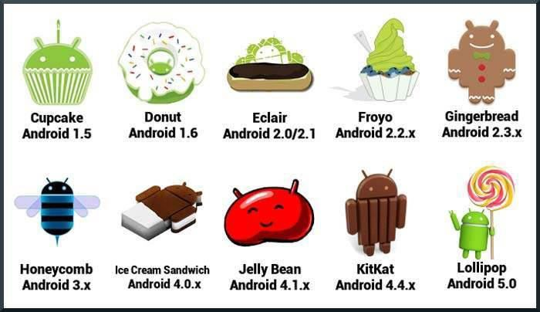

History of Android(con...)

Slide 65
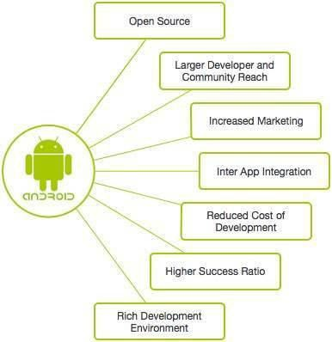
Why Android?

Slide 66
Android Applications
Android applications are usually developed in the Java language using the Android Software Development Kit
Once developed, Android applications can be packaged easily and sold out either through a store such as Google Play, SlideME, Opera Mobile Store, Mobango, F-droid and the Amazon Appstore.
Android powers hundreds of millions of mobile devices in more than 190 countries around the world. It's the largest installed base of any mobile platform and growing fast.
Every day more than 1 million new Android devices are activated worldwide.

Slide 67
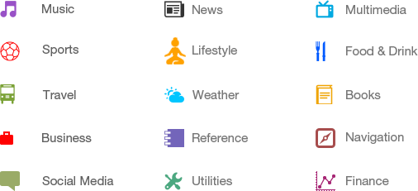
Categories of Android applications
There are many android applications in the market

Slide 68
Features of Android
Android is a powerful operating system competing with Apple iPhone and supports great features.
Features | Description
Beautiful UI | Android OS basic screen provides a beautiful and intuitive user interface.
Connectivity | GSM/EDGE, CDMA, EV-DO, UMTS, Bluetooth, Wi-Fi, LTE, NFC and WiMAX.
Storage | SQLite, a lightweight relational database, is used for data storage purposes.

Slide 69
Features of Android (con...)
Features | Description
Media support | H.263, H.264, MPEG-4 SP, AMR, AMR-WB, AAC, HE-AAC, AAC 5.1, MP3, MIDI, Ogg Vorbis, WAV, JPEG, PNG, GIF, and BMP
Messaging | SMS and MMS
Web browser | Based on the open-source WebKit layout engine, coupled with Chrome's V8 JavaScript engine supporting HTML5 and CSS3.
Multi-touch | Android has native support for multi-touch which was initially made available in handsets such as the HTC Hero.
Multi-tasking | User can jump from one task to another and same time various application can run simultaneously.

Slide 70
Features of Android (con...)
Features | Description
Resizable widgets | Widgets are resizable, so users can expand them to show more content or shrink them to save space
Multi- Language | The use of more than one language
GCM | Google Cloud Messaging (GCM) is a service that lets developers send short message data to their users on Android devices.
Wi-Fi Direct | A technology that lets apps discover and pair directly, over a high-bandwidth peer-to-peer connection.
Android Beam | A popular NFC-based technology that lets users instantly share, just by touching two NFC-enabled phones together.

Slide 71
What does it have that other’s don’t?
Google Map Applications
Background Services and Applications
Shared Data and Inter-process communication
All Applications are created Equal
P2P Inter-device Application Messaging
MVC2 Architecture
68

Slide 72
MVC2
Commonly used for developing user interfaces that divides the related program logic into three interconnected elements.
To separate internal representations of information from the ways information is presented to and accepted from the user.
The goal of the MVC design pattern is to separate the application object (model) from the way it is represented to the user (view) from the way in which the user controls it (controller).

Slide 73
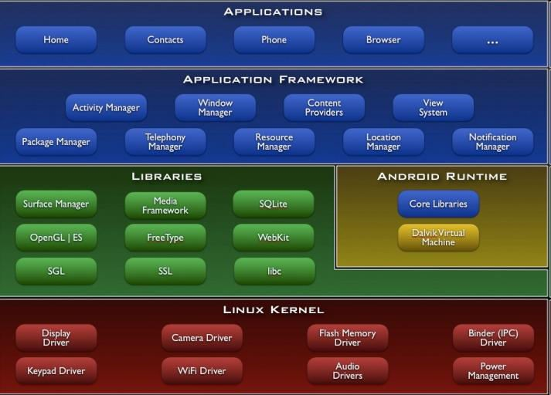
5. Architecture
71

Slide 74
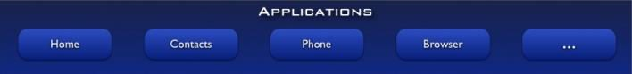
Android S/W Stack - Applications
Android provides a set of core applications:
Email Client
SMS Program
Calendar
Maps
Browser
Contacts
Etc
All applications are written using the Java language.
72

Slide 75
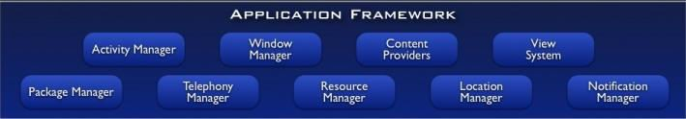
Android S/W Stack –
Application Framework
Enabling and simplifying the reuse of components
Developers have full access to the same framework APIs used by the core applications.
Users are allowed to replace components.
73

Slide 76
Application Framework
The Application Framework layer provides many higher-level services to applications in the form of Java classes. Application developers are allowed to make use of these services in their applications.
The Android framework includes the following key services −
Activity Manager − Controls all aspects of the application lifecycle and activity stack.
Content Providers − Allows applications to publish and share data with other applications.
Resource Manager − Provides access to non-code embedded resources such as strings, color settings and user interface layouts.
Notifications Manager − Allows applications to display alerts and notifications to the user.
View System − An extensible set of views used to create application user interfaces.

Slide 77
Android S/W Stack –
App Framework (Cont)
Features
Feature | Role
View System | Used to build an application, including lists, grids, text boxes, buttons, and embedded web browser
Content Provider | Enabling applications to access data from other applications or to share their own data
Resource Manager | Providing access to non-code resources (localized strings, graphics, and layout files)
Notification Manager | Enabling all applications to display customer alerts in the status bar
Activity Manager | Managing the lifecycle of applications and providing a common navigation back-stack
74

Slide 78
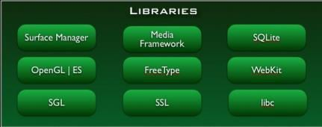
Android S/W Stack - Libraries
Including a set of C/C++ libraries used by components of the Android system
Interface through Java
Surface manager – Handling UI Windows
2D and 3D graphics
Media codes, SQLite, Browser engine
75

Slide 79
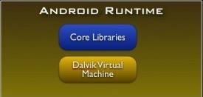
Android S/W Stack - Runtime
Core Libraries
Providing most of the functionality available in the core libraries of the Java language
APIs
Data Structures
Utilities
File Access
Network Access
Graphics
76

Slide 80
Android S/W Stack – Runtime (Cont)
Dalvik Virtual Machine
Providing environment on which every Android application runs
Each Android application runs in its own process, with its own instance of the Dalvik VM.
Dalvik has been written such that a device can run multiple VMs efficiently.
Register-based virtual machine
77

Slide 81
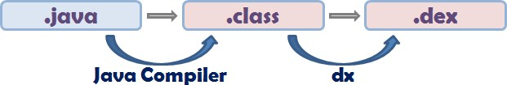
Android S/W Stack – Runtime (Cont)
Dalvik Virtual Machine (Cont)
Executing the Dalvik Executable (.dex) format
.dex format is optimized for minimal memory footprint.
Compilation
Relying on the Linux Kernel for:
Threading
Low-level memory management
78

Slide 82
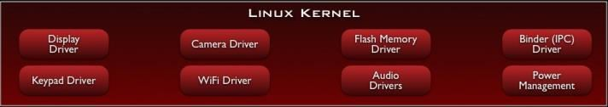
Android S/W Stack – Linux Kernel
Relying on Linux Kernel 2.6 for core system services
Memory and Process Management
Network Stack
Driver Model
Security
Providing an abstraction layer between the H/W and the rest of the S/W stack
79

Slide 83
Android S/W Stack – Linux Kernel
Security:
The Linux kernel handles the security between the application and the system.
2. Memory Management:
It efficiently handles the memory management thereby providing the freedom to develop our apps.
3. Process Management:
It manages the process well, allocates resources to processes whenever they need them.
4. Network Stack:
It effectively handles the network communication.
5. Driver Model:
It ensures that the application works. Hardware manufacturers can build their drivers into the Linux build.

Slide 84
Android development setup
Follow the instructions ...
Download the software from the URL: http://developer.android.com/sdk/index.html
Install the following Softwares:
Android SDK
Eclipse IDE (3.4 or newer)
Android Development Tools (ADT) Eclipse plug-in
Bring with you (optional):
Android OS enabled Mobile device
USB cable so you can test your app on your phone
80

Slide 85
Application Fundamentals
Apps are written in Java
Bundled by Android Asset Packaging Tool
Every App runs its own Linux process
Each process has it’s own Java Virtual Machine
Each App is assigned a unique Linux user ID
Apps can share the same user ID to see
each other’s files
81

Slide 86
Applications
Lifestyle applications for senior citizens
Environmental applications that give data about pollution levels.
Emergency services ( Hospitals, Police station etc.,)
Bus services
Games
E-governance
Google map
82

Slide 87
6. UI Layouts
The basic building block for user interface is a View object which is created from the View class
It occupies a rectangular area on the screen and is responsible for drawing and event handling.
View is the base class for widgets, which are used to create interactive UI components like buttons, text fields, etc.

Slide 88
UI Layouts (con…)
The ViewGroup is a subclass of View and provides invisible container that hold other Views or other ViewGroups and define their layout properties.
At third level we have different layouts which are subclasses of ViewGroup class
A typical layout defines the visual structure for an Android user interface.

Slide 89
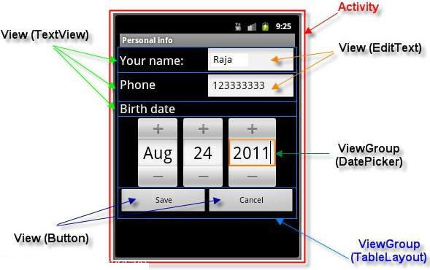
UI Layouts (con…)

Slide 90
UI Layouts (con…)
To declare the layout using simple XML file main_layout.xml which is located in the res/layout folder of your project.
A layout may contain any type of widgets such as buttons, labels, textboxes, and so on.

Slide 91
A simple XML file having LinearLayout
<?xml version="1.0" encoding="utf-8"?>
<LinearLayout xmlns:android="http://schemas.android.com/apk/res/android"
android:layout_width="fill_parent" android:layout_height="fill_parent" android:orientation="vertical" >
<TextView android:id="@+id/text"
android:layout_width="wrap_content"
android:layout_height="wrap_content"
android:text="This is a TextView" />
<Button android:id="@+id/button"
android:layout_width="wrap_content"
android:layout_height="wrap_content"
android:text="This is a Button" />
<!-- More GUI components go here -->
</LinearLayout>

Slide 92
LinearLayout (con…)
Once the layout has created, it can loaded by the help of application code
Sample Code
public void onCreate(Bundle savedInstanceState)
{
super.onCreate(savedInstanceState); setContentView(R.layout.activity_main);
}

Slide 93
Layout Types
Linear Layout
Relative Layout
Table Layout
Absolute Layout
Frame Layout
List View
Grid View

Slide 94
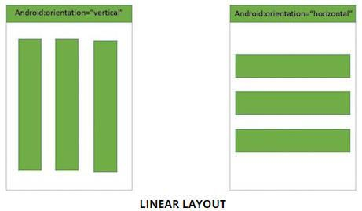
Linear Layout
Linear Layout is a view group that aligns all children in either vertically or horizontally.

Slide 95
Attributes
Attribute | Description
android:id | This is the ID which uniquely identifies the layout.
android:gravity | This specifies how an object should position its content, on both the X and Y axes. Possible values are top, bottom, left, right, center, center_vertical, center_horizontal etc.
android:orientation | This specifies the direction of arrangement and you will use "horizontal" for a row, "vertical" for a column. The default is horizontal.

Slide 96
Example
<?xml version="1.0" encoding="utf-8"?>
<LinearLayout xmlns:android="http://schemas.android.com/apk/ res/android"
android:layout_width="fill_parent" android:layout_height="fill_parent" android:orientation="vertical" >
<!-- More GUI components go here -->
</LinearLayout>

Slide 97
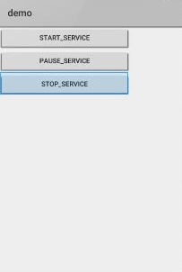
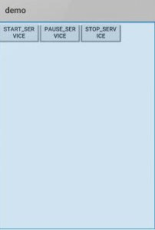
Output

Slide 98
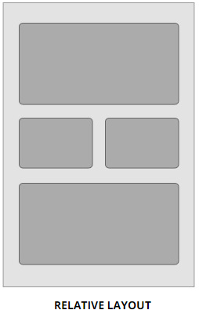
Relative Layout
Relative Layout enables you to specify how child views are positioned relative to each other.
The position of each view can be specified as relative to sibling elements or relative to the parent.

Slide 99
Attributes
Attribute | Description
android:id | This is the ID which uniquely identifies the layout.
android:gravit y | This specifies how an object should position its content, on both the X and Y axes. Possible values are top, bottom, left, right, center, center_vertical, center_horizontal etc.
By default, all child views are drawn at the top-left of the layout, so you must define the position of each view using the various layout properties.

Slide 100
Example
<RelativeLayout xmlns:android="http://schemas.android.co m/apk/res/android" android:layout_width="fill_parent" android:layout_height="fill_parent" android:paddingLeft="16dp" android:paddingRight="16dp" >
<!-- More GUI components go here -->
</RelativeLayout>

Slide 101
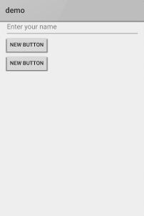
Output

Slide 102
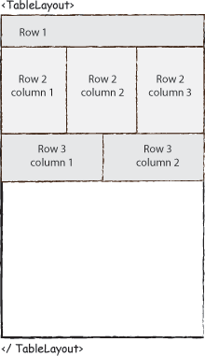
Table Layout
TableLayout going to be arranged groups of views into rows and columns.
Use the <TableRow> element to build a row in the table.
Each row has zero or more cells; each cell can hold one View object
It don’t display border lines for their rows, columns, or cells.

Slide 103
Attributes
Attribute | Description
android:id | This is the ID which uniquely identifies the layout.
android:collapseColum ns | This specifies the zero- based index of the columns to collapse.
android:shrinkColumns | The zero-based index of the columns to shrink.
android:stretchColumns | The zero-based index of the columns to stretch.

Slide 104
Example
<TableLayout xmlns:android="http://schemas.android.com/apk/res/and roid"
android:layout_width="fill_parent" android:layout_height="fill_parent">
<TableRow
android:layout_width="fill_parent" android:layout_height="fill_parent">
<!-- More GUI components go here -->
</TableRow>
<!-- More Table rows go here -->
</TableLayout>

Slide 105
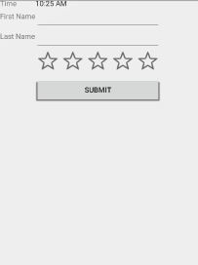
Output

Slide 106
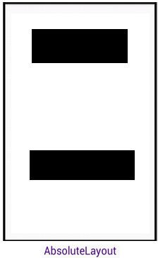
Absolute Layout
Absolute Layout lets you specify exact locations (x/y coordinates) of its children.
Absolute layouts are less flexible and harder to maintain than other types of layouts without absolute positioning.

Slide 107
Attributes
Attribute | Description
android:id | This is the ID which uniquely identifies the layout.
android:layout_x | This specifies the x- coordinate of the view.
android:layout_y | This specifies the y- coordinate of the view.

Slide 108
Example
<AbsoluteLayout xmlns:android="http://schemas.android.com/apk/res/andr oid"
android:layout_width="fill_parent" android:layout_height="fill_parent">
<Button android:layout_width="100dp" android:layout_height="wrap_content" android:text="OK"
android:layout_x="50px" android:layout_y="361px" />
<!-- More GUI components go here -->
</AbsoluteLayout>

Slide 109
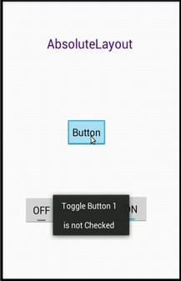
Output

Slide 110
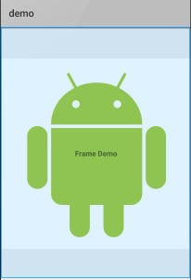
Frame Layout
Frame Layout is designed to block out an area on the screen to display a single item.
Generally, Frame Layout should be used to hold a single child view.
We can add multiple children to a FrameLayout and control their position by assigning gravity to each child, using the android:layout_gravity attribute.

Slide 111
Example
<FrameLayout xmlns:android="http://schemas.android.co m/apk/res/android" android:layout_width="fill_parent" android:layout_height="fill_parent">
<!-- More GUI components go here -->
</FrameLayout>

Slide 112
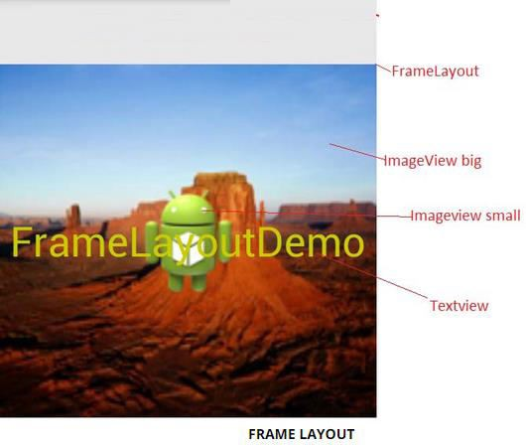
Output

Slide 113
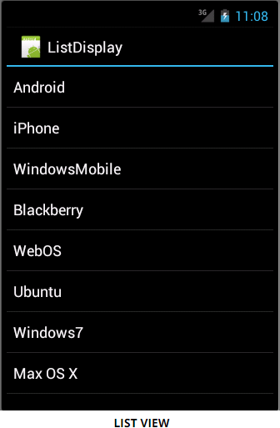
List View
List View is a view which groups several items and display them in vertical scrollable list.
The list items are automatically inserted to the list using
an Adapter that pulls content from a source such as an array or database.

Slide 114
Attributes
Attribute | Description
android:id | This is the ID which uniquely identifies the layout.
android:divider | This is drawable or color to draw between list items.
android:dividerHeight | This specifies height of the divider. This could be in px, dp, sp, in, or mm.
android:entries | Specifies the reference to an array resource that will populate the ListView.
android:footerDividersEnable d | When set to false, the ListView will not draw the divider before each footer view. The default value is true.
android:headerDividersEnabl ed | When set to false, the ListView will not draw the divider after each header view. The default value is true.

Slide 115
Example
<LinearLayout xmlns:android="http://schemas.android.com/apk/res/and roid" xmlns:tools="http://schemas.android.com/tools" android:layout_width="match_parent" android:layout_height="match_parent" android:orientation="vertical"
tools:context=".ListActivity" >
<ListView android:id="@+id/mobile_list" android:layout_width="match_parent" android:layout_height="wrap_content" >
</ListView>
</LinearLayout>

Slide 116
Output

Slide 117
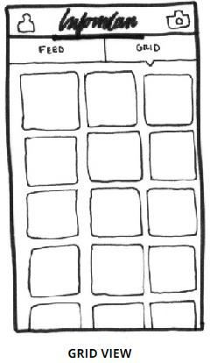
Grid View
Grid View shows items in two-dimensional scrolling grid (rows & columns)
The grid items are not necessarily predetermined but they automatically inserted to the layout using a ListAdapter

Slide 118
Grid View (con…)
An adapter actually bridges between UI components and the data source that fill data into UI Component.
Adapter can be used to supply the data to spinner, list view, grid view etc.

Slide 119
Attributes
Attribute | Description
android:id | This is the ID which uniquely identifies the layout.
android:columnWidth | This specifies the fixed width for each column. This could be in px, dp, sp, in, or mm.
android:gravity | Specifies the gravity within each cell. Possible values are top, bottom, left, right, center, center_vertical, center_horizontal etc.
android:horizontalSpaci ng | Defines the default horizontal spacing between columns. This could be in px, dp, sp, in, or mm.
android:numColumns | Defines how many columns to show.
android:verticalSpacing android:stretchMode | Defines the default vertical spacing between rows. This could be in px, dp, sp, in, or mm. Defines how columns should stretch to fill the available empty space, if any

Slide 120
Example
<?xml version="1.0" encoding="utf-8"?>
<GridView xmlns:android="http://schemas.android.com/apk/res/androi d"
android:id="@+id/gridview"
android:layout_width="fill_parent" android:layout_height="fill_parent" android:columnWidth="90dp"
android:numColumns="auto_fit" android:verticalSpacing="10dp" android:horizontalSpacing="10dp" android:stretchMode="columnWidth"
android:gravity="center" />

Slide 121
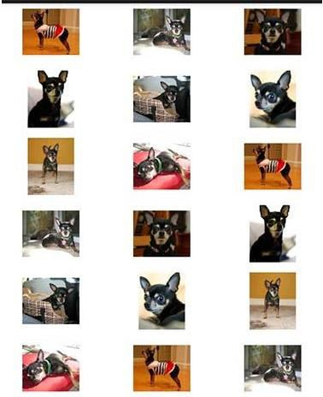
Output

Slide 122
7. UI Controls / Widgets
Input controls are the interactive components in your app's user interface.
Android provides a wide variety of controls you can use in your UI, such as buttons, text fields, seek bars, check box, zoom buttons, toggle buttons, and many more

Slide 123
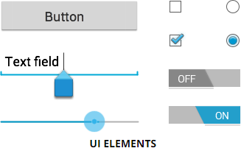
UI Controls (con…)

Slide 124
UI Controls (con…)
TextView
EditText
Button
ImageButton
ToggleButton
AutoCompleteTextVie w
CheckBox
RadioButton
RadioGroup
ProgressBar
Spinner
TimePicker
DatePicker

Slide 125
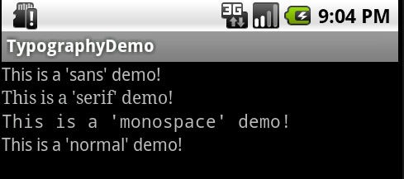
TextView Control
A TextView displays text to the user and optionally allows them to edit it.
A TextView is a complete text editor, however the basic class is configured to not allow editing.

Slide 126
Attributes
Attribute | Description
android:id | This is the ID which uniquely identifies the control.
android:fontFamily | Font family (named by string) for the text.
android:inputType | The type of data being placed in a text field. Phone, Date, Time, Number, Password etc.
android:text | Text to display.
android:textAllCaps | Present the text in ALL CAPS. Possible value either "true" or "false".
android:textColor | Text color. May be a color value.
android:textSize | Size of the text. Recommended dimension type for text is "sp" for scaled-pixels.

Slide 127
Example
In XML:
<TextView
android:id="@+id/text_id" android:layout_width="300dp" android:layout_height="200dp" android:capitalize="characters" android:text="hello_world" android:textColor="@android:color/holo_blue_dark" android:textColorHighlight="@android:color/primary_text_d ark" android:layout_centerVertical="true" android:layout_alignParentEnd="true" android:textSize="50dp"/>
In JAVA:
TextView txtView = (TextView) findViewById(R.id.text_id);

Slide 128
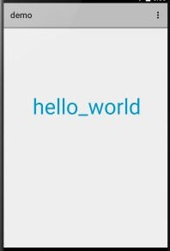
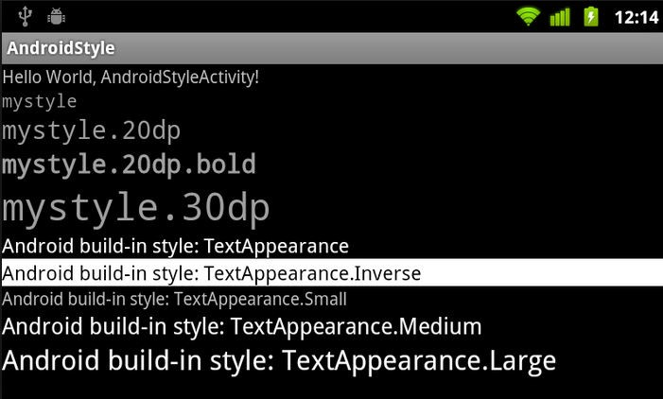
Output

Slide 129
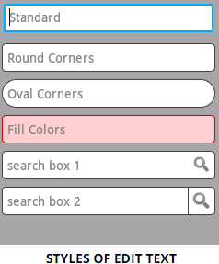
EditText Control
A EditText is an overlay over TextView that configures itself to be editable.
It is the predefined subclass of TextView that includes rich editing capabilities.

Slide 130
Attributes
Attribute | Description
android:autoText | If set, specifies that this TextView has a textual input method and automatically corrects some common spelling errors.
android:drawableBotto m | This is the drawable to be drawn below the text.
android:drawableRight | This is the drawable to be drawn to the right of the text.
android:editable | If set, specifies that this TextView has an input method.
android:text | This is the Text to display.

Slide 131
Example
In XML:
<EditText
android:id="@+id/edittext" android:layout_width="fill_parent" android:layout_height="wrap_content" android:layout_alignLeft="@+id/button" android:layout_below="@+id/textView1" android:layout_marginTop="61dp" android:ems="10" android:text="@string/enter_text"
android:inputType="text" /> In JAVA:
EditText eText = (EditText) findViewById(R.id.edittext);

Slide 132

Output

Slide 133

Button Control
A Button is a Push-button which can be pressed, or clicked, by the user to perform an action.

Slide 134
Attributes
Attribute | Description
android:autoText | If set, specifies that this TextView has a textual input method and automatically corrects some common spelling errors.
android:drawableBotto m | This is the drawable to be drawn below the text.
android:drawableRight | This is the drawable to be drawn to the right of the text.
android:editable | If set, specifies that this TextView has an input method.
android:text | This is the Text to display.

Slide 135
Example
In XML:
<Button android:layout_width="wrap_content" android:layout_height="wrap_content"
android:text="Button" android:id="@+id/button" android:layout_alignTop="@+id/editText" android:layout_alignLeft="@+id/textView1" android:layout_alignStart="@+id/textView1" android:layout_alignRight="@+id/editText" android:layout_alignEnd="@+id/editText" />

Slide 136
Example (con…)
In JAVA:
Button b1=(Button)findViewById(R.id.button); b1.setOnClickListener(new View.OnClickListener()
{
@Override
public void onClick(View v)
{
Toast.makeText(MainActivity.this,"YOUR
MESSAGE",Toast.LENGTH_LONG).show();
}
});

Slide 137

Output

Slide 138
ImageButton Control
A ImageButton is a AbsoluteLayout which enables you to specify the exact location of its children.
This shows a button with an image (instead of text) that can be pressed or clicked by the user.

Slide 139
Attributes
Attribute | Description
android:adjustViewBounds | Set this to true if you want the ImageView to adjust its bounds to preserve the aspect ratio of its drawable.
android:baseline | This is the offset of the baseline within this view.
android:baselineAlignBottom | If true, the image view will be baseline aligned with based on its bottom edge.
android:cropToPadding | If true, the image will be cropped to fit within its padding.
android:src | This sets a drawable as the content of this ImageView.

Slide 140
Example
In XML:
<ImageButton android:layout_width="wrap_content" android:layout_height="wrap_content" android:id="@+id/imageButton" android:layout_centerVertical="true" android:layout_centerHorizontal="true" android:src="@drawable/abc"/>

Slide 141
Example (con…)
In JAVA:
ImageButton imgButton =(ImageButton) findViewById(R.id.imageButton); imgButton.setOnClickListener(new View.OnClickListener()
{
@Override public void onClick(View v)
{
Toast.makeText(getApplicationContext(),“ImageButton is clicked",Toast.LENGTH_LONG).show();
}
});

Slide 142

Output

Slide 143

ToggleButton Control
A ToggleButton displays checked/unchecked states as a button.
It is basically an on/off button with a light indicator.

Slide 144
Attributes
Attribute | Description
android:disabledAlpha | This is the alpha to apply to the indicator when disabled.
android:textOff | This is the text for the button when it is not checked.
android:textOn | This is the text for the button when it is checked.

Slide 145
Example
In XML:
<ToggleButton
android:layout_width="wrap_content" android:layout_height="wrap_content"
android:textOn="ON" android:id="@+id/toggleButton1“ android:checked="true" />
<ToggleButton android:layout_width="wrap_content" android:layout_height="wrap_content"
android:textOff="Off" android:id="@+id/toggleButton2" android:checked="true“ />
<Button
android:layout_width="wrap_content" android:layout_height="wrap_content
"
android:id="@+id/button2" android:text="ClickMe“ />

Slide 146
Example (con…)
In JAVA:
ToggleButton tg1,tg2;
Button b1; tg1=(ToggleButton)findViewById(R.id.toggleButton1); tg2=(ToggleButton)findViewById(R.id.toggleButton2); b1=(Button)findViewById(R.id.button2); b1.setOnClickListener(new View.OnClickListener() { @Override public void onClick(View v) { StringBuffer result = new StringBuffer();
result.append("You have clicked first ON Button").append(tg1.getText()); result.append("\You have clicked Second ON Button
").append(tg2.getText());
Toast.makeText(MainActivity.this,result.toString(),Toast.LENGTH_SHORT)
.show(); } });

Slide 147

Output

Slide 148
AutoCompleteTextView Control
A AutoCompleteTextView is a view that is similar to EditText, except that it shows a list of completion suggestions automatically while the user is typing.
The list of suggestions is displayed in drop down menu.
The user can choose an item from there to replace the content of edit box with.

Slide 149
Attributes
Attribute | Description
android:completionHintVie w | This defines the hint view displayed in the drop down menu.
android:completionThresho ld | This defines the number of characters that the user must type before completion suggestions are displayed in a drop down menu.
android:dropDownAnchor | This is the View to anchor the auto- complete dropdown to.
android:dropDownHeight | This specifies the basic height of the dropdown.
android:dropDownSelector | This is the selector in a drop down list.
android:dropDownWidth | This specifies the basic width of the dropdown.
android:popupBackground | This sets the background.

Slide 150
Example
In XML:
<AutoCompleteTextView android:id="@+id/autoCompleteTextView1 " android:layout_width="wrap_content" android:layout_height="wrap_content" android:layout_alignLeft="@+id/textView2" android:layout_below="@+id/textView2" android:layout_marginTop="54dp" android:ems="10" />

Slide 151
Example (con…)
In JAVA:
AutoCompleteTextView autocompletetextview; String[] arr = { "Paries,France", "PA,United States","Parana,Brazil", "Padua,Italy", "Pasadena,CA,United States"};
autocomplete = (AutoCompleteTextView) findViewById(R.id.autoCompleteTextView1);
ArrayAdapter<String> adapter = new ArrayAdapter<String> (this,android.R.layout.select_dialog_item, arr);
autocomplete.setThreshold(2); autocomplete.setAdapter(adapter);

Slide 152

Output

Slide 153

CheckBox Control
A CheckBox is an on/off switch that can be toggled by the user.
To use check-boxes when presenting users with a group of selectable options that are not mutually exclusive.

Slide 154
Attributes
Attribute | Description
android:autoText | If set, specifies that this TextView has a textual input method and automatically corrects some common spelling errors.
android:drawableBot tom | This is the drawable to be drawn below the text.
android:drawableRig ht | This is the drawable to be drawn to the right of the text.
android:editable | If set, specifies that this TextView has an input method.
android:text | This is the Text to display.

Slide 155
Example
In XML:
<CheckBox android:id="@+id/checkBox1" android:layout_width="wrap_content" android:layout_height="wrap_content"
android:text="Do you like android“ android:checked="false“ />
<CheckBox android:id="@+id/checkBox2" android:layout_width="wrap_content" android:layout_height="wrap_content"
android:text="Do you like android "
android:checked="false“ />

Slide 156
Example (con…)
In JAVA:
CheckBox ch1,ch2; Button b1,b2;
ch1=(CheckBox)findViewById(R.id.checkBox1); ch2=(CheckBox)findViewById(R.id.checkBox2); b1=(Button)findViewById(R.id.button);
b1.setOnClickListener(new View.OnClickListener() {
@Override
public void onClick(View v) { StringBuffer result = new StringBuffer();
result.append("Thanks : ").append(ch1.isChecked()); result.append("\nThanks: ").append(ch2.isChecked()); Toast.makeText(MainActivity.this, result.toString(), Toast.LENGTH_LONG).show(); }
});

Slide 157

Output

Slide 158

RadioButton Control
A RadioButton has two states: either checked or unchecked.
This allows the user to select one option from a set.

Slide 159
Example
<RadioButton android:text="HTML" android:id="@+id/radioButton
3“
android:checked="false“ />
In XML:
<RadioGroup
<RadioButton
</RadioGroup>
android:text="JAVA"
android:id="@+id/radioButton1"
android:checked="false“ />
<RadioButton
android:text="ANDROID" android:id="@+id/radioButton2“ android:checked="false“ />

Slide 160
Example (con…)
In JAVA:
RadioButton rb1; RadioGroup rg1; Button b1;
addListenerRadioButton();
private void addListenerRadioButton() {
rg1 = (RadioGroup) findViewById(R.id.radioGroup);
b1 = (Button) findViewById(R.id.button1); b1.setOnClickListener(new View.OnClickListener() { @Override public void onClick(View v) {
int selected=rg1.getCheckedRadioButtonId(); rb1=(RadioButton)findViewById(selected); Toast.makeText(MainActivity.this,rb1.getText(),Toast.LE NGTH_LONG).show(); } }); }

Slide 161

Output

Slide 162
RadioGroup Control
A RadioGroup class is used for set of radio buttons.
If we check one radio button that belongs to a radio group, it automatically unchecks any previously checked radio button within the same group.
(Refer RadioButton)

Slide 163
Progress Bar Control
Progress bars are used to show progress of a task.
A class called ProgressDialog that allows you to create progress bar.
Syntax:
ProgressDialog progress = new ProgressDialog(this);
For example, when you are uploading or downloading something from the internet, it is better to show the progress of download/upload to the user.

Slide 164
ProgressDialog class methods
Methods | Description
getMax() | This method returns the maximum value of the progress.
incrementProgressBy(int diff) | This method increments the progress bar by the difference of value passed as a parameter.
setIndeterminate(boolean indeterminate) | This method sets the progress indicator as determinate or indeterminate.
setMax(int max) | This method sets the maximum value of the progress dialog.
setProgress(int value) | This method is used to update the progress dialog with some specific value.
show(Context context, CharSequence title, CharSequence message) | This is a static method, used to display progress dialog.

Slide 165
Example
In XML:
<Button android:layout_width="wrap_content" android:layout_height="wrap_content" android:text="DOWNLOAD" android:onClick="download" android:id="@+id/button1" android:layout_marginLeft="125dp" android:layout_marginStart="125dp" android:layout_centerVertical="true" />

Slide 166
Example (con…)
In JAVA:
Button b1;
private ProgressDialog progress;
b1 = (Button) findViewById(R.id.button1); public void download(View view){
progress=new ProgressDialog(this); progress.setMessage("Downloading Music");
progress.setProgressStyle(ProgressDialog.STYLE_HORI ZONTAL); progress.setIndeterminate(true); progress.setProgress(0);
progress.show();

Slide 167
Example (con…)
final int totalProgressTime = 100; final Thread t = new Thread() { @Override public void run() {
int jumpTime = 0;
while(jumpTime < totalProgressTime) { try {
sleep(200);
jumpTime += 5; progress.setProgress(jumpTime); }
catch (InterruptedException e) { }
} } };
t.start(); }

Slide 168


Output

Slide 169

Spinner Control
Spinner allows you to select an item from a drop down menu.

Slide 170
Example
In XML:
<Spinner android:id="@+id/spinner" android:layout_width="fill_parent" android:layout_height="wrap_content" android:prompt="@string/spinner_title"/>
In JAVA:
Spinner spinner = (Spinner) findViewById(R.id.spinner); spinner.setOnItemSelectedListener(this);
List<String> categories = new ArrayList<String>();
categories.add(“Automobile"); categories.add(“Business Services");

Slide 171
Example (con…)
categories.add("Computers"); categories.add("Education"); categories.add("Personal"); categories.add("Travel");
ArrayAdapter<String> dataAdapter = new ArrayAdapter<String>(this, android.R.layout.simple_spinner_item, categories);
dataAdapter.setDropDownViewResource(android.R.layout.
simple_spinner_dropdown_item);
spinner.setAdapter(dataAdapter);

Slide 172
Example (con…)
public void onItemSelected(AdapterView<?> parent, View view, int position, long id) {
String item = parent.getItemAtPosition(position).toString();
Toast.makeText(parent.getContext(), "Selected: "
+ item, Toast.LENGTH_LONG).show();
}

Slide 173


Output

Slide 174

TimePicker Control
Time Picker allows you to select the time of day in either 24 hour or AM/PM mode.
The time consists of hours, minutes and clock format.
Android provides this functionality through TimePicker class.

Slide 175
Methods
Methods | Description
is24HourView() | This method returns true if this is in 24 hour view else false
isEnabled() | This method returns the enabled status for this view
setCurrentHour(Integer currentHour) | This method sets the current hour
setCurrentMinute(Integer currentMinute) | This method sets the current minute
setEnabled(boolean enabled) | This method set the enabled state of this view
setIs24HourView(Boolean is24HourView) | This method set whether in 24 hour or AM/PM mode
setOnTimeChangedListener(TimePi cker.OnTimeChangedListener onTimeChangedListener) | This method Set the callback that indicates the time has been adjusted by the user

Slide 176
Example
In XML:
<TimePicker android:id="@+id/timePicker1" android:layout_width="wrap_content" android:layout_height="wrap_content" />
In JAVA:
TimePicker timePicker1;
timePicker1 = (TimePicker)findViewById(R.id.timePicker1); int hour = timePicker1.getCurrentHour();
int min = timePicker1.getCurrentMinute();

Slide 177

Output

Slide 178

DatePicker Control
Date Picker allows you to select the date consisting of day, month and year in your custom user interface.
Android provides DatePicker and DatePickerDialog components.

Slide 179
Methods
Methods | Description
getDayOfMonth() | This method gets the selected day of month
getMonth() | This method gets the selected month
getYear() | This method gets the selected year
setMaxDate(long maxDate) | This method sets the maximal date supported by this DatePicker in milliseconds
setMinDate(long minDate) | This method sets the minimal date supported by this NumberPicker in milliseconds
setSpinnersShown(boolean shown) | This method sets whether the spinners are shown
updateDate(int year, int month, int dayOfMonth) | This method updates the current date
getCalendarView() | This method returns calendar view
getFirstDayOfWeek() | This Method returns first day of the week

Slide 180
Example
In JAVA:
DatePicker datePicker; Calendar calendar;
int year, month, day;
calendar = Calendar.getInstance(); year = calendar.get(Calendar.YEAR);
month = calendar.get(Calendar.MONTH);
day = calendar.get(Calendar.DAY_OF_MONTH);

Slide 181
8. Event Handling
Events are a useful way to collect data about a user's interaction with interactive components of Applications.
Like button presses or screen touch etc.
The Android framework maintains an event queue as first-in, first-out (FIFO) basis.
Capture these events in program and take appropriate action as per requirements.

Slide 182
Event Handling (con…)
Event Management
Event Listeners
An event listener is an interface in the View class that contains a single callback method.
These methods will be called by the Android framework when the View to which the listener has been registered is triggered by user interaction with the item in the UI.

Slide 183
Event Handling (con…)
Event Handlers
When an event happens and we have registered in the event listener for the event, the event listener calls the Event Handlers, which is the method that actually handles the event.
Event Listeners Registration
Event Registration is the process by which an Event Handler gets registered with an Event Listener so that the handler is called when the Event Listener fires the event

Slide 184
Event Listeners & Event Handlers
Event Handler | Event Listener | Description
onClick() | OnClickListener() | This is called when the user either clicks or touches or focuses upon any widget like button, text, image etc.
onLongClick() | OnLongClickListener() | This is called when the user either clicks or touches or focuses upon any widget like button, text, image etc. for one or more seconds.
onFocusChange () | OnFocusChangeListene r() | This is called when the widget looses its focus.

Slide 185
Event Listeners & Event
Handlers (con…)
onKey() | OnFocusChangeListener () | This is called when the user is focused on the item and presses or releases a hardware key on the device.
onTouch() | OnTouchListener() | This is called when the user presses the key, releases the key, or any movement gesture on the screen.
onMenuItemClick() | OnMenuItemClickListene r() | This is called when the user selects a menu item.
onCreateContextMenu () | onCreateContextMenuIte mListener() | This is called when the context menu is being built(as the result of a sustained "long click”).

Slide 186
Event Listeners Registration
Event Registration is the process by which an Event Handler gets registered with an Event Listener so that the handler is called when the Event Listener fires the event.
Top 3 ways are,
Using an Anonymous Inner Class
Activity class implements the Listener interface.
Using Layout file activity_main.xml to specify event handler directly.

Slide 187
Example
Using an Anonymous Inner Class Button b1; b1=(Button)findViewById(R.id.button);
b1.setOnClickListener(new View.OnClickListener()
{ @Override
public void onClick(View v) {
TextView txtView = (TextView) findViewById(R.id.textView); txtView.setTextSize(25); } });

Slide 188
Example (con…)
Activity class implements the Listener interface BtnListener listener = new BtnListener();
Button b1;
b1=(Button)findViewById(R.id.btnNum0Id)).setOnClickListener(listener);
private class BtnListener implements OnClickListener { // On-click event handler for all the buttons @Override public void onClick(View view) {
//ToDo the code here….
} }

Slide 189
Example (con…)
Using Layout file activity_main.xml to specify event handler directly
In XML
<Button
android:layout_width="wrap_content" android:layout_height="wrap_content" android:text="Small font"
android:id="@+id/button“ android:onClick=“Font_Change”/>

Slide 190
Example (con…)
In JAVA
public void Font_Change(View v) { TextView txtView = (TextView)
findViewById(R.id.textView);
txtView.setTextSize(25);
}

Slide 191

9. Tools - Eclipse IDE

Slide 192

Eclipse IDE (con…)

Slide 193

New Android Project Creation

Slide 194

Giving Name Application /
Project

Slide 195

Con…

Slide 196

Icon Customization

Slide 197

Customized Icon

Slide 198

Activity type selection

Slide 199

Customize the activity name

Slide 200

Default code appear in Eclipse IDE

Slide 201

Creating AVD Manager

Slide 202

AVD Configuration

Slide 203

Launching the AVD

Slide 204

Launching the AVD (con…)

Slide 205

AVD – Emulator

Slide 206

Configure the Logcat

Slide 207

Application running status displayed in Logcat

Slide 208

Output

Slide 209

10. Application Structure

Slide 210
Application Structure (con…)
src
gen
bin
res/drawable-hdpi
res/layout
res/values
AndroidManifest.xml

Slide 211
Application Structure (con…)
src
This contains the .java source files for your project.
By default, it includes an MainActivity.java source file having an activity class that runs when your app is launched using the app icon.
gen
This contains the .R file, a compiler-generated file that references all the resources found in your project.
User should not modify this file.

Slide 212
Application Structure (con…)
bin
This folder contains the Android package
files .apk built by the ADT during the build process and everything else needed to run an Android application.
res/drawable-hdpi
This is a directory for drawable objects that are designed for high-density screens.
res/layout
This is a directory for files that define your app's user interface.

Slide 213
Application Structure (con…)
res/values
This is a directory for other various XML files that contain a collection of resources, such as strings and colours definitions.
AndroidManifest.xml
This is the manifest file which describes the fundamental characteristics of the app and defines each of its components.

Slide 214
11. AndroidManifest
The component you develop as a part of your application, you must declare all its components in a manifest.xml which resides at the root of the application project directory.
This file works as an interface between Android OS and your application, so if you do not declare your component in this file, then it will not be considered by the OS.

Slide 215
AndroidManifest (con…)
Default manifest file will look like as following file
<manifest xmlns:android="http://schemas.android.com/apk/res/and roid" package="com.example.helloworld"
android:versionCode="1"
android:versionName="1.0" >
<uses-sdk
android:minSdkVersion="8"
android:targetSdkVersion="22" />

Slide 216
AndroidManifest (con…)
<application android:icon="@drawable/ic_launcher" android:label="@string/app_name" android:theme="@style/AppTheme" >
<activity android:name=".MainActivity"
android:label="@string/title_activity_main" >
<intent-filter>
<action android:name="android.intent.action.MAIN"
/>
<category android:name="android.intent.category.LAUNCHER"/>
</intent-filter> </activity> </application> </manifest>

Slide 217
AndroidManifest (con…)
<application>...</application> tags enclosed the components related to the application.
Attribute android:icon will point to the application icon available underres/drawable-hdpi.
The @string/app_name refers to the app_name string defined in the strings.xml file, which is "HelloWorld"
The <activity> tag is used to specify an activity and android:name attribute specifies the fully qualified class name of the Activity subclass.

Slide 218
AndroidManifest (con…)
The android:label attributes specifies a string to use as the label for the activity / application.
The action for the intent filter is named android.intent.action.MAIN to indicate that this activity serves as the entry point for the application.
The category for the intent-filter is named android.intent.category.LAUNCHER to indicate that the application can be launched from the device's launcher icon.

Slide 219
AndroidManifest (con…)
Following is the list of tags which you will use in your manifest file to specify different Android application components.
<activity> elements for activities
<service> elements for services
<receiver> elements for broadcast receivers
<provider> elements for content providers

Slide 220
Practices
To know about the history, features and various versions of Android
Draw the Android architecture
To study various tools used in Android development
To study about Eclipse IDE
To develop first Android App “Hello World”
To implement the various Android layouts
To implement the various Android UI controls
To study the importance of Android application
structure and Android manifest file
218

